Slide 1
Change-point Models for Spatio-temporal Ordinal Data
Abe Durrant, Candace Berrett, Soudeep Deb, and Siddharth Rawat

Slide 2
Overview
Spatio-Temporal data is often reported with an ordinal response variable rather than continuous
Often with this type data we are interested in both the relationships between covariates and this ordinal response as well as changes among these relationships (change-points)
We also may be interested in changes in the spatio-temporal behavior
We propose a model that accounts for these challenges
Use a dataset involving COVID-19 from New York

Slide 3
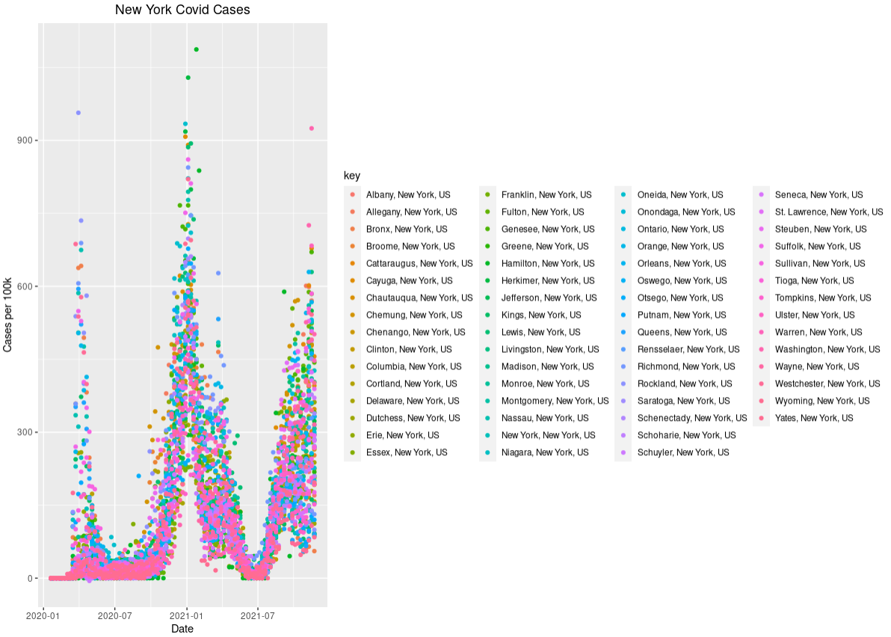
New York COVID-19 Dataset
62 counties in New York State
Cases are reported by county
Weekly case numbers
Each week is classified into a category from 1 to 4 based on the number of cases per 100k

Slide 4
Challenges with the COVID-19 dataset
We are interested in modeling all the following:
The spatio-temporal correlation
Changes in relationships among covariates and case levels
Changes in the spatio-temporal behavior
While models exist involving change-points in spatio-temporal data for continuous data, there is no such model for an ordinal response
While we can model the continuous data, the CDC has stated that the categories (or case levels) are more reliable

Slide 5
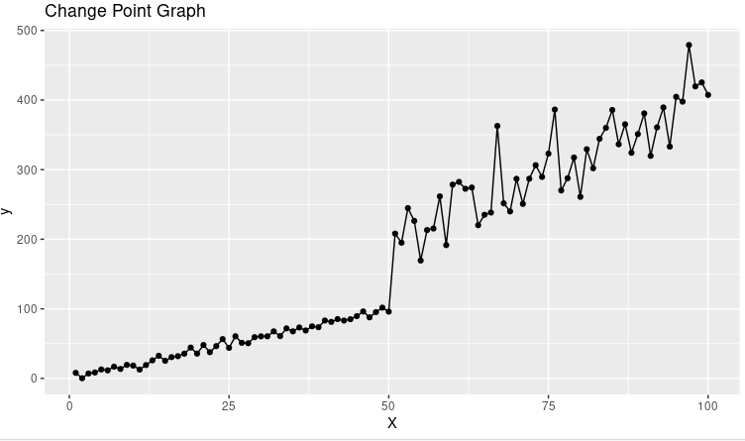

Change-Points
Denote a change point as τ
Before and after τ we have different values of both β and ${\text{σ}}^{2}$
We may be interested in an estimate of where this change point is at (value of τ)

Slide 6
Why change-points are important with COVID-19?
Vaccines or other factors may cause cases to behave differently at different times
Learning when these change points happen can be important for researchers
Our response to the pandemic has changed a lot over time which could lead to different relationships across time

Slide 7
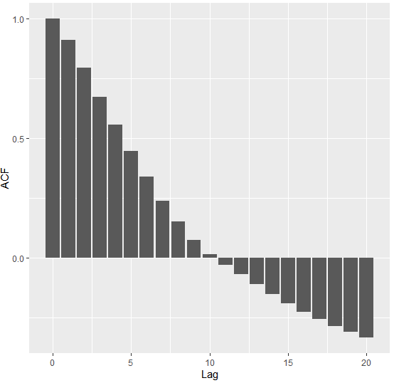
Spatial & Temporal Correlation
The case level of one week is likely related to past weeks
The case levels in one county are likely related to those in other counties
We need to account for this in our model

Slide 8
Correlation before and after the change-point
3 types of temporal correlation to consider
Between weeks before the change-point
Between weeks after the change-point
Between weeks before and weeks after the change point
Use terms V, W, U

Slide 9
Ordinal Data
How does looking at case levels change our model?
m = 4
Categories in our current dataset:
Level 1 (< 10 cases per 100k)
Level 2 (< 50 cases per 100k)
Level 3 (< 100 cases per 100k)
Level 4 (> 100 cases per 100k)

Slide 10
Review
We want a model that is structured around each of these characteristics of the data
Adjust for spatio-temporal correlation
Allow for a possible change-point
Model the ordinal response
Use a Bayesian approach

Slide 11

Proposed Model
$π= \left\{\begin{aligned}{U+X}_{1}β_{1}+V+ ε_{1 } if t≤ τ \\ {U+X}_{2}β_{2}+W+ ε_{2} if t> τ\end{aligned}\right.$
Vector-matrix notation
U is our term that represents correlation throughout the whole dataset
V and W are specific to times before and after the change point

Slide 12
Current Work

Slide 13
County by County
Fit models county by county first to see if change points in some counties may be related to those in others
Are county trends similar?
How does this approach compare to fitting one model across the entire state?
Using continuous counts for now for simplicity

Slide 14
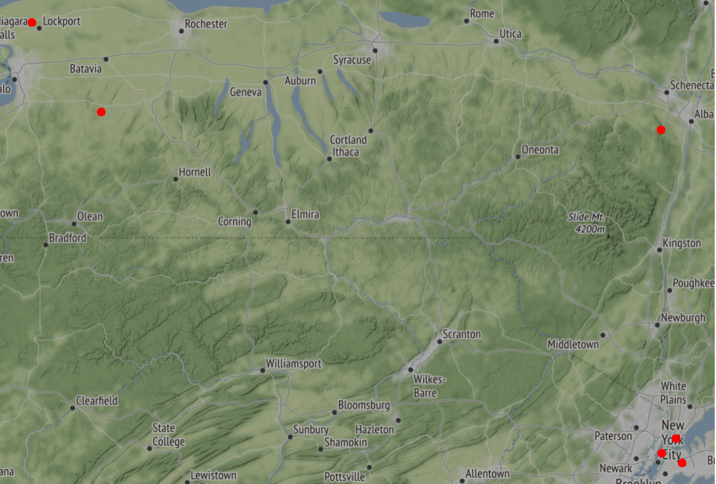

Slide 15
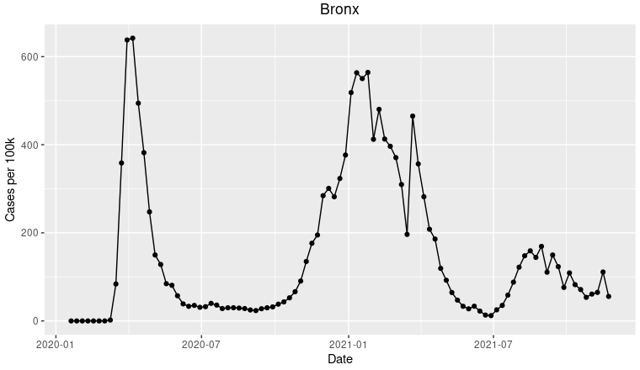
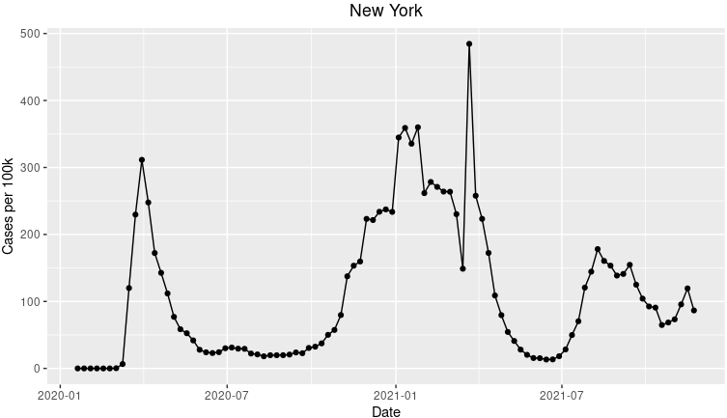
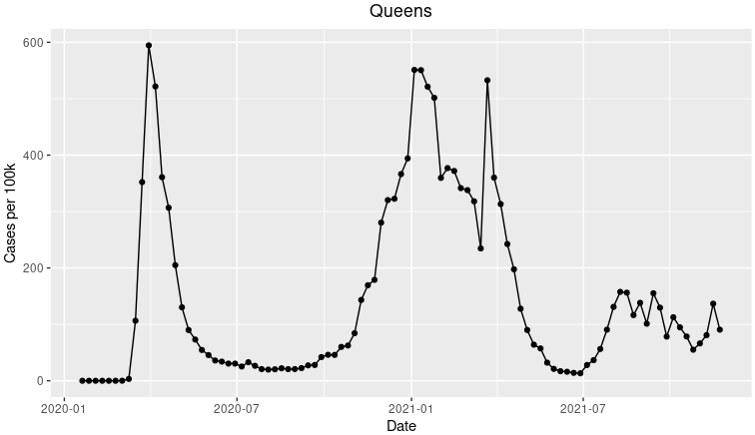
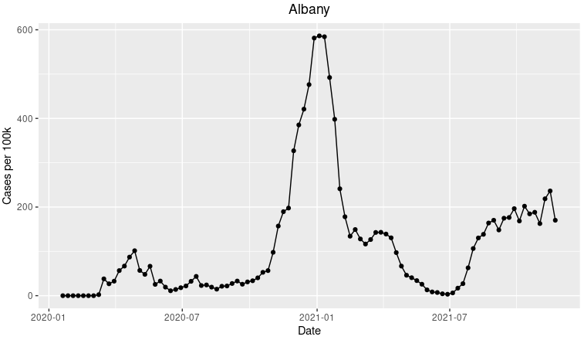
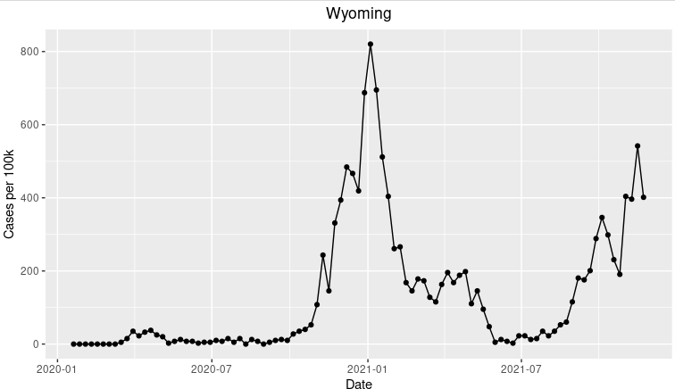
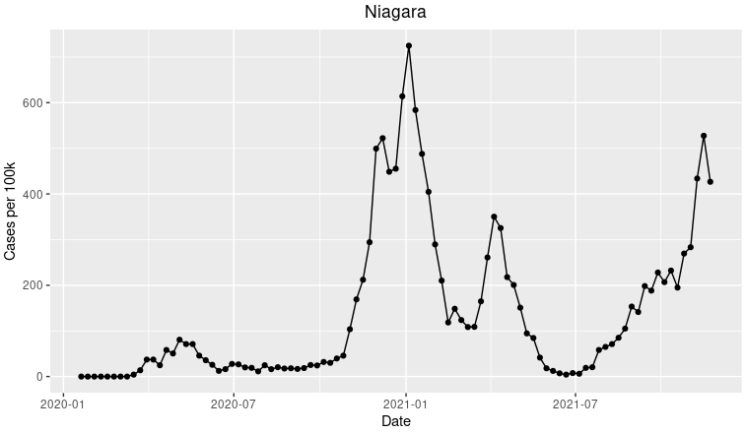

Slide 16
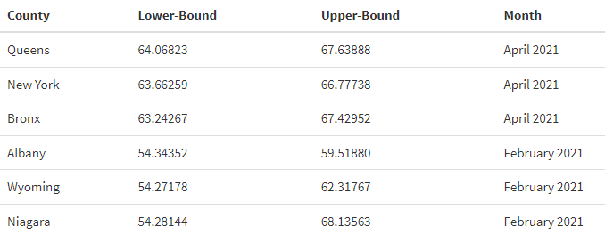
Estimated Change Points

Slide 17
Next Steps/Challenges
Model case levels rather than the continuous counts
Working model including spatial correlation across counties
Computation time
Use vaccination data and other information as covariates
Compare models for counties to a model over the entire state

Slide 18
Other Applications
Modeling market behavior involving change-points
Modeling the spread of other diseases
Any spatio-temporal variable that is better modeled as an ordinal response

Slide 19
Questions?

Slide 20
References
Daykin, A.R., Moffatt, P.G., 2002. Analyzing ordered responses: A review of the ordered probit model. Understanding Statistics: Statistical Issues in Psychology, Education, and the Social Sciences 1, 157–166.
Dechi, B.O., 2019. Bayesian Analysis of Ordinal Outcomes Through Latent Variable Approach. Ph.D. thesis. The University of Texas at El Paso.

